Slide 1

California Housing Business Analysis
By: Eric Ye
Instructor: Vijay Kumar
March 27th, 2021

Slide 2
Introduction
Real Estate company collected data based on median house prices in 1990 in California
They want to predict the house prices, and see which variables collected have significance with the target variable
Dataset contains 20641 observations, and 10 variables
GOAL: Identify the variables most associated with the target variable house price, and provide results and suggestions to the business

Slide 3
Variables studied
Longitude: measure of how far west a house is; a higher value is farther west
Latitude: measure of how far north a house is; higher value is farther north
houseMedianAge: Median age of a house within a block
totalRooms: Total number of rooms within a block
totalBedrooms: Total number of bedrooms within a block
Population: Total number of people residing within a block
Households: total number of households in a block
MedianIncome: Median income for households within a block (measured in tens of thousands of dollars)
OceanProximity: Location of the house w.r.t. ocean/sea
MedianHouseValue: Median price for the households within a block (US dollars) (Target variable)

Slide 4
Steps
Data cleaning/ preprocessing (Missing values, Encoding, etc)
Basic Statistics
Data Visualizations
Univariate/ Bivariate Analysis
Model building/ Linear Regression

Slide 5
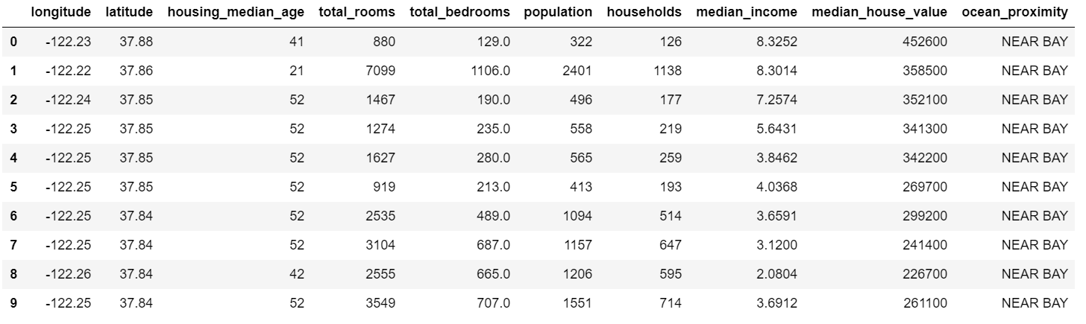
Cleaning/ Preprocessing

Slide 6
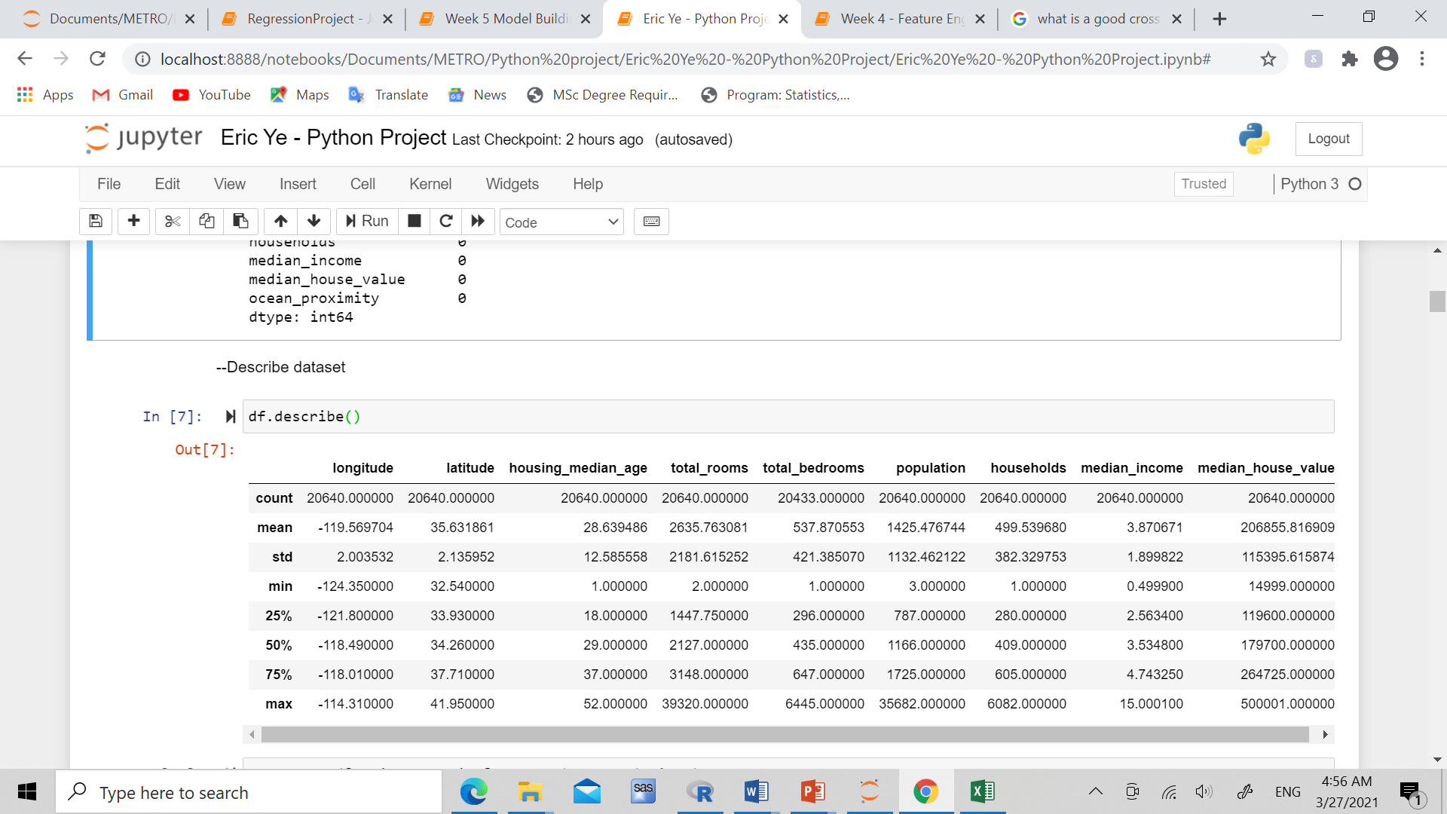
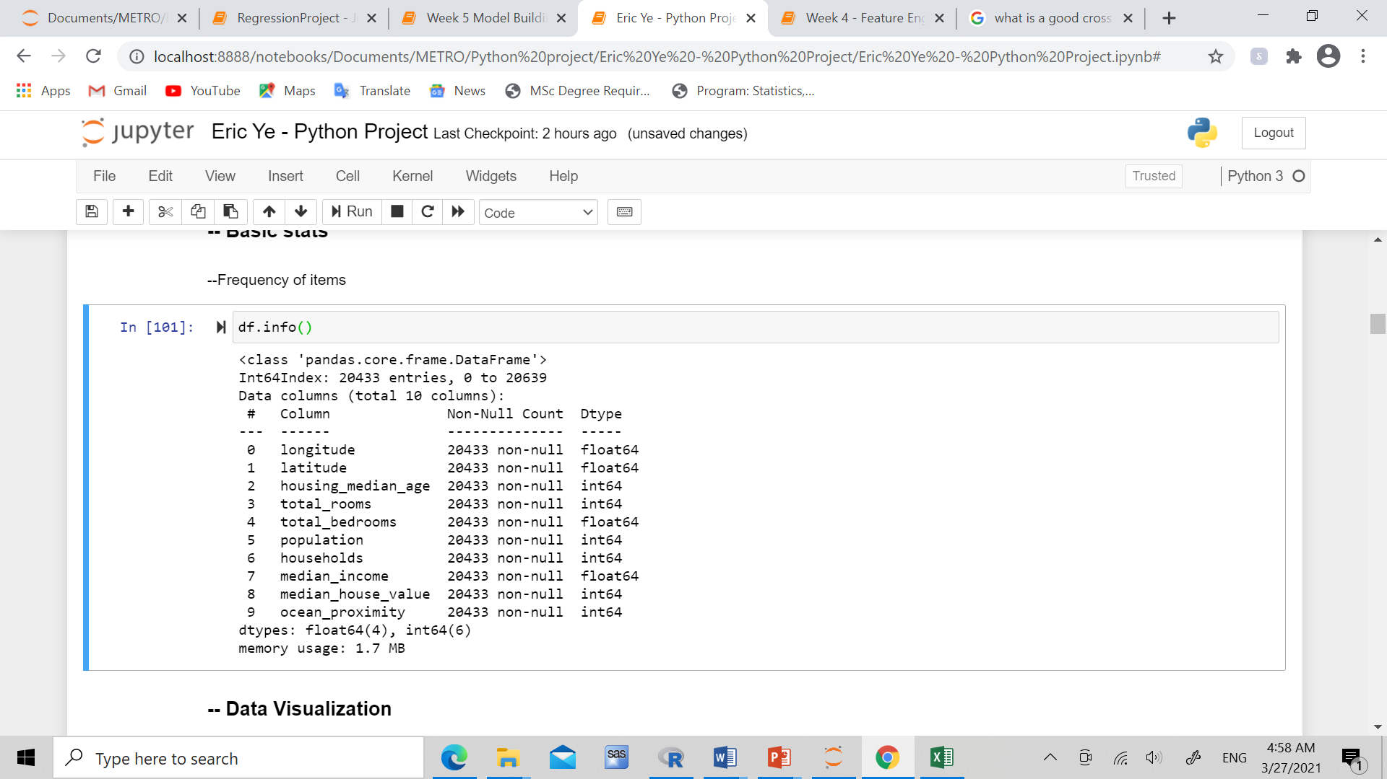
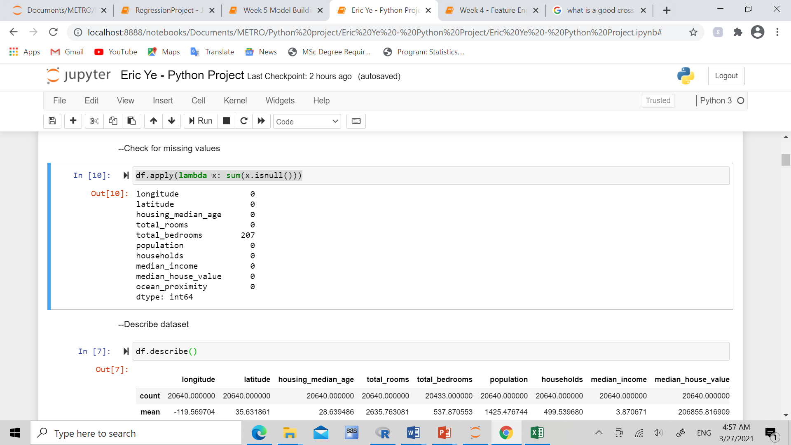
Missing Values Treatment

Slide 7
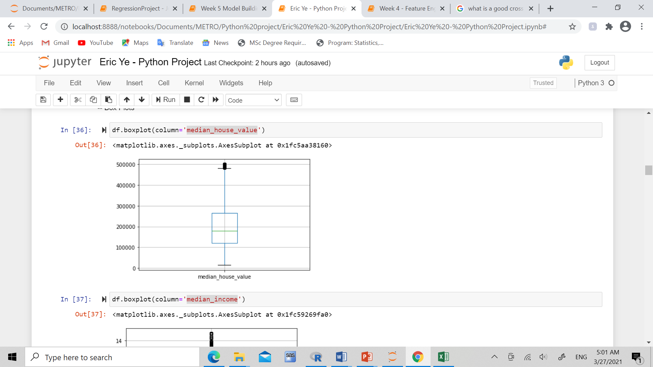
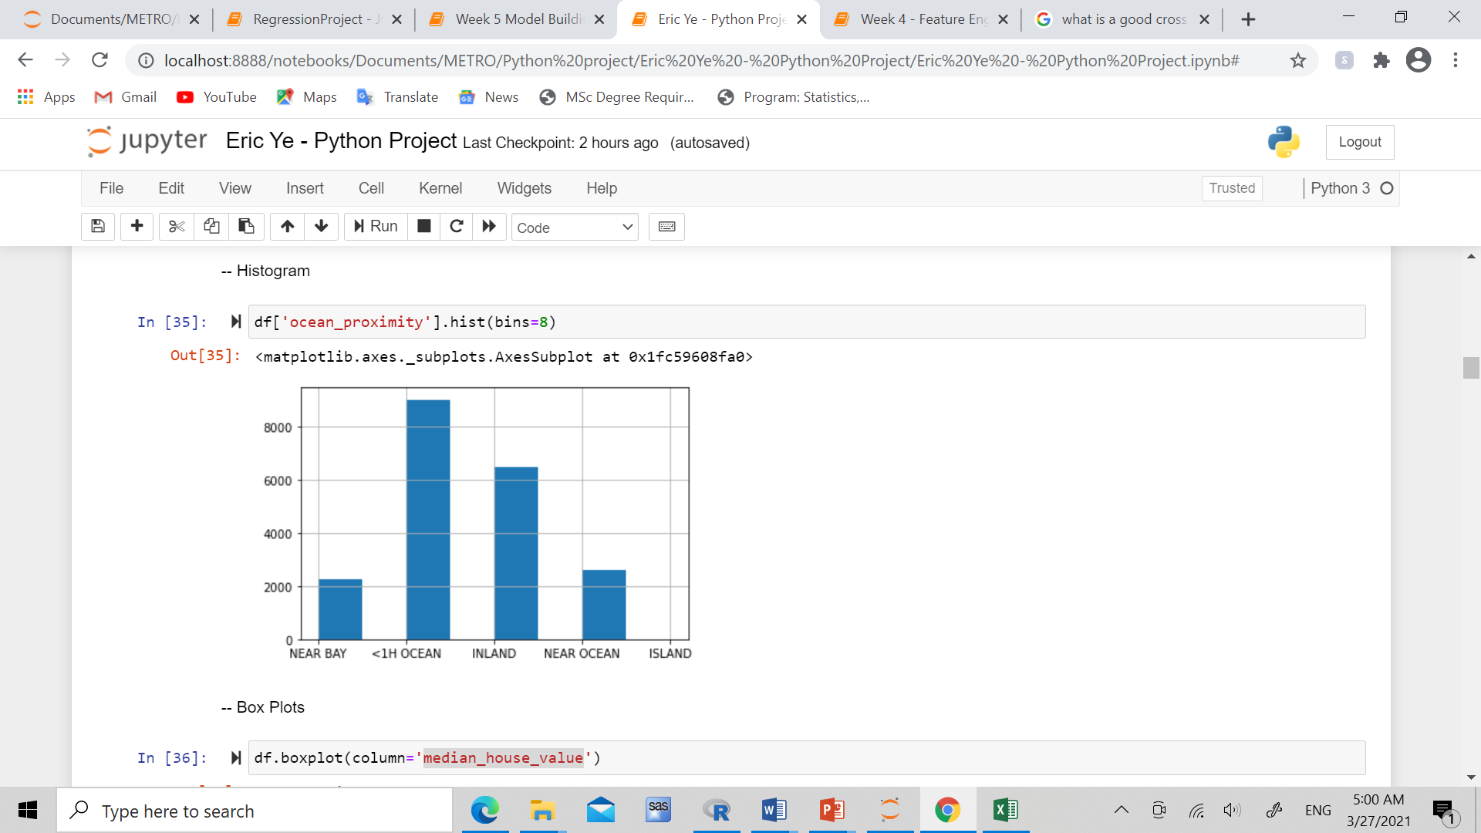
Data Visualization/ Univariate

Slide 8
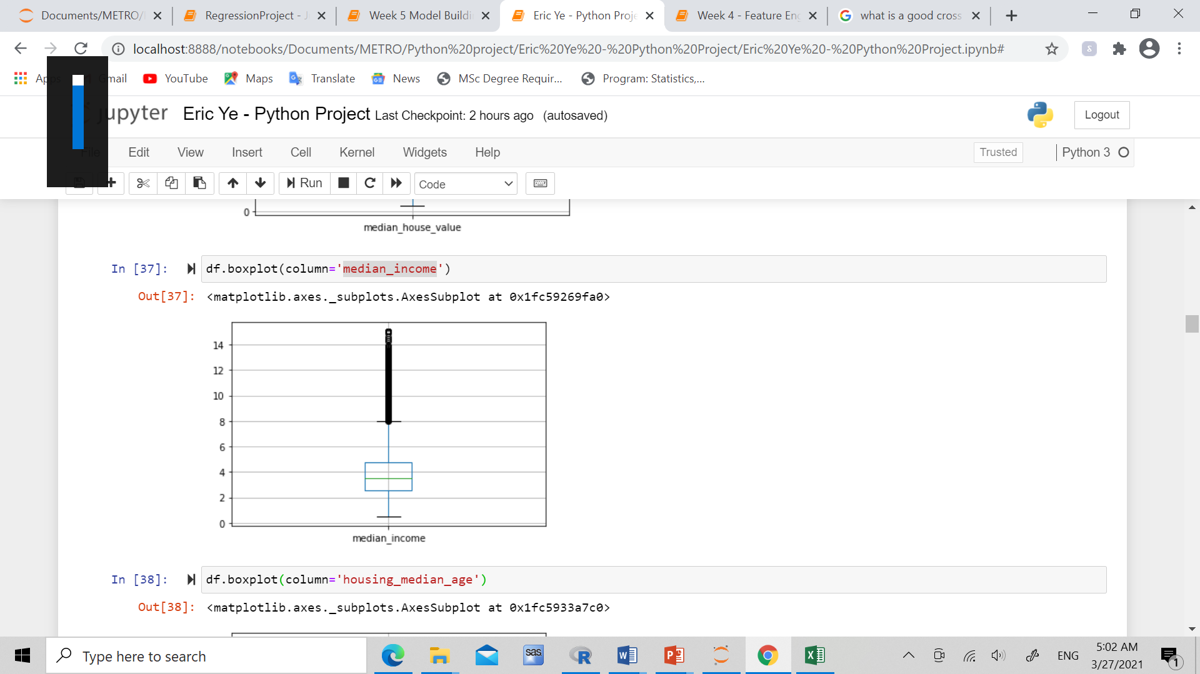
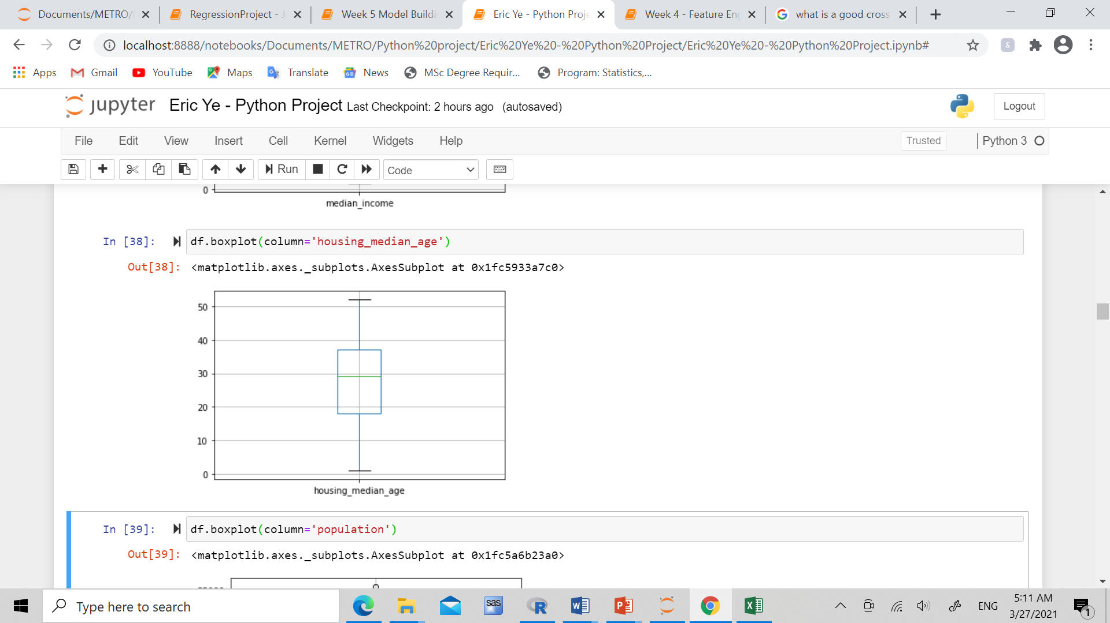

Slide 9
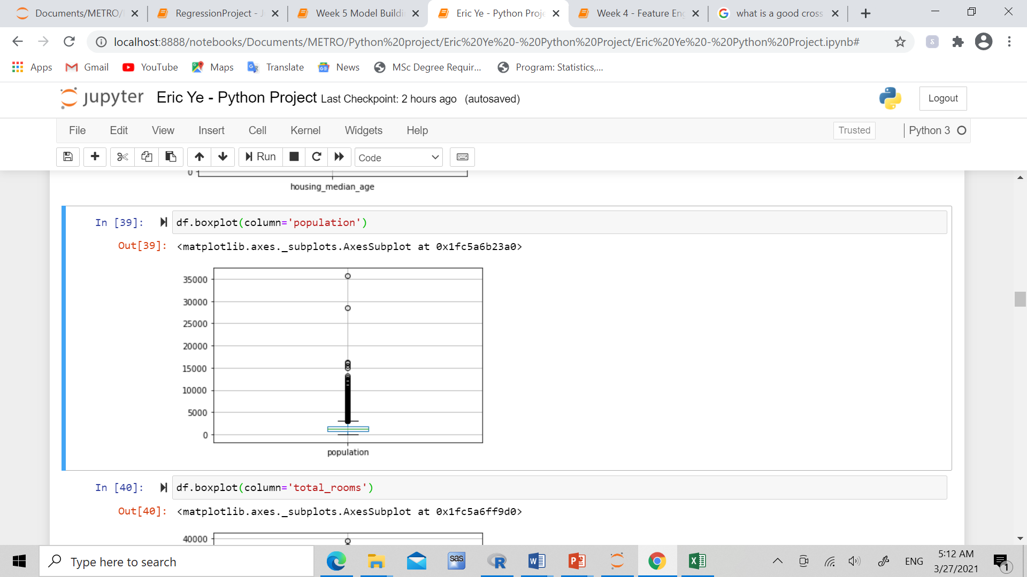
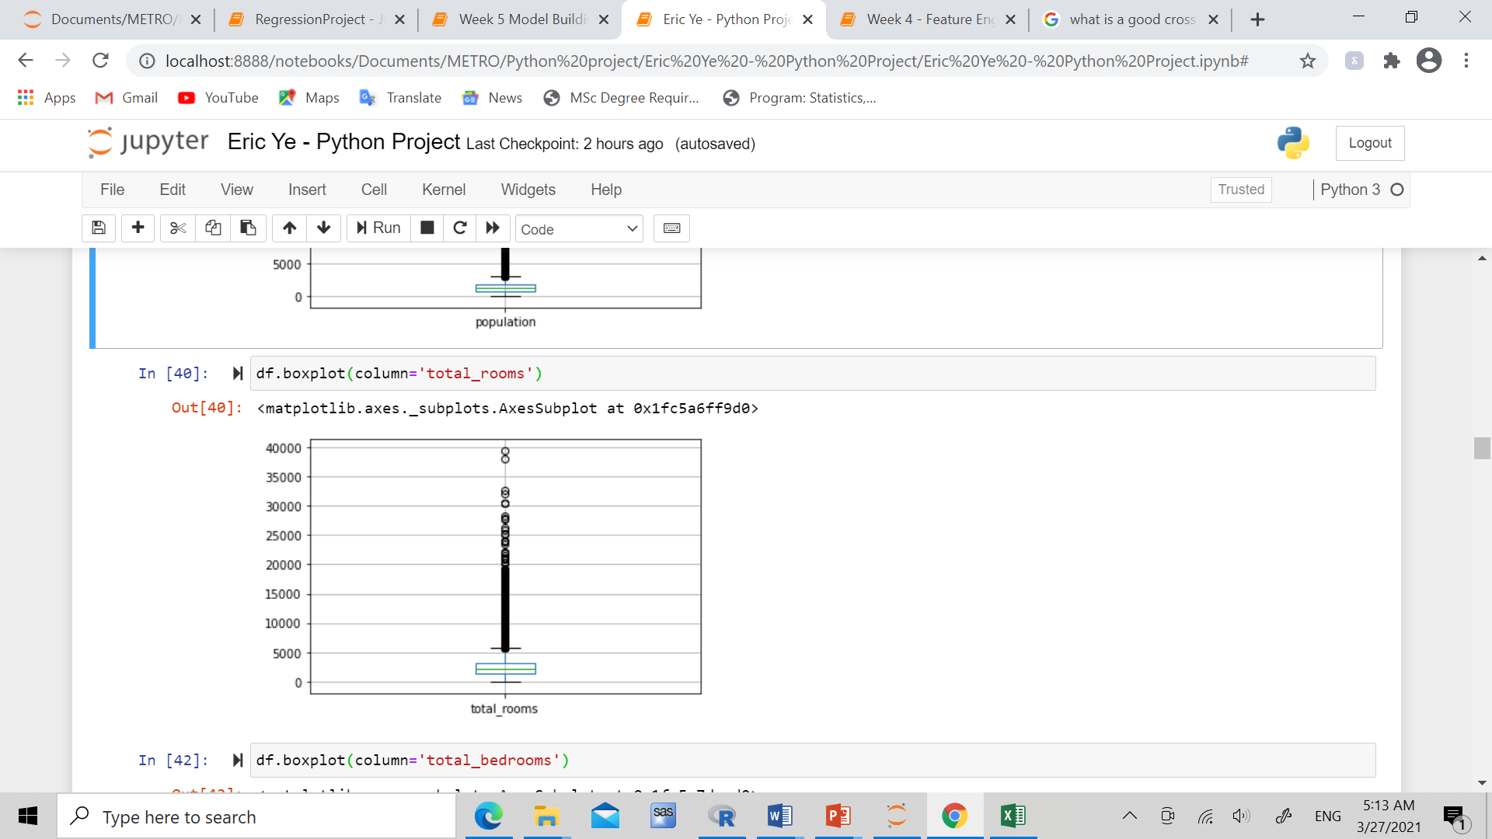
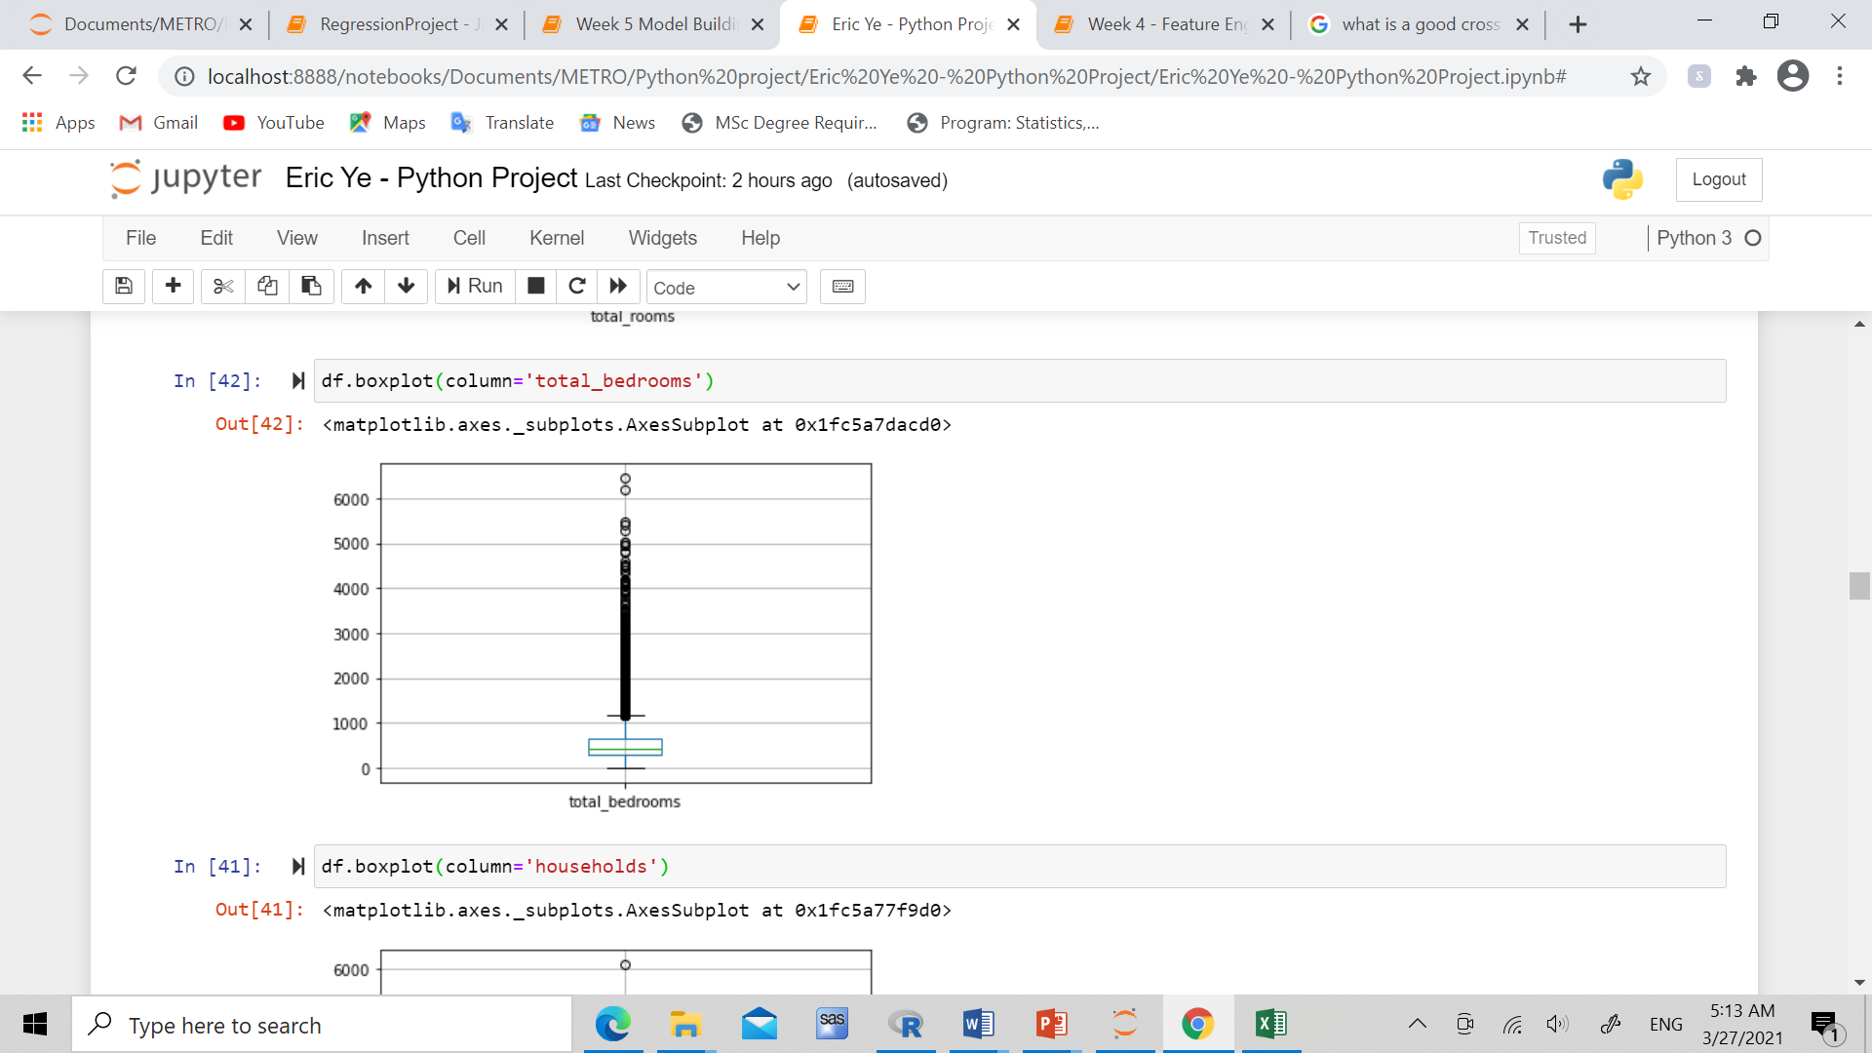
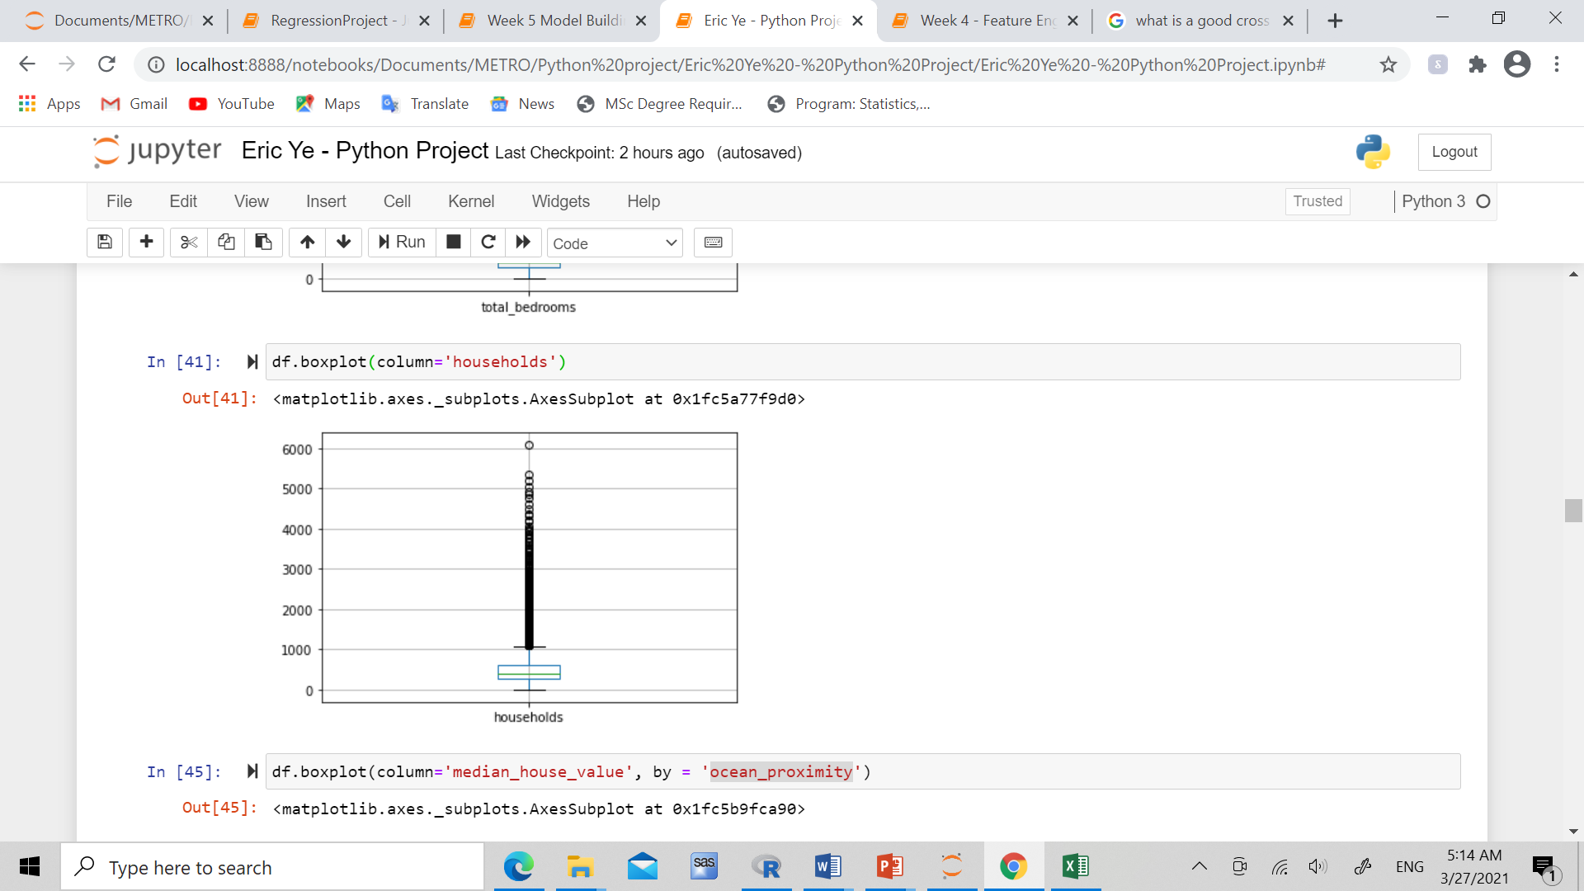

Slide 10
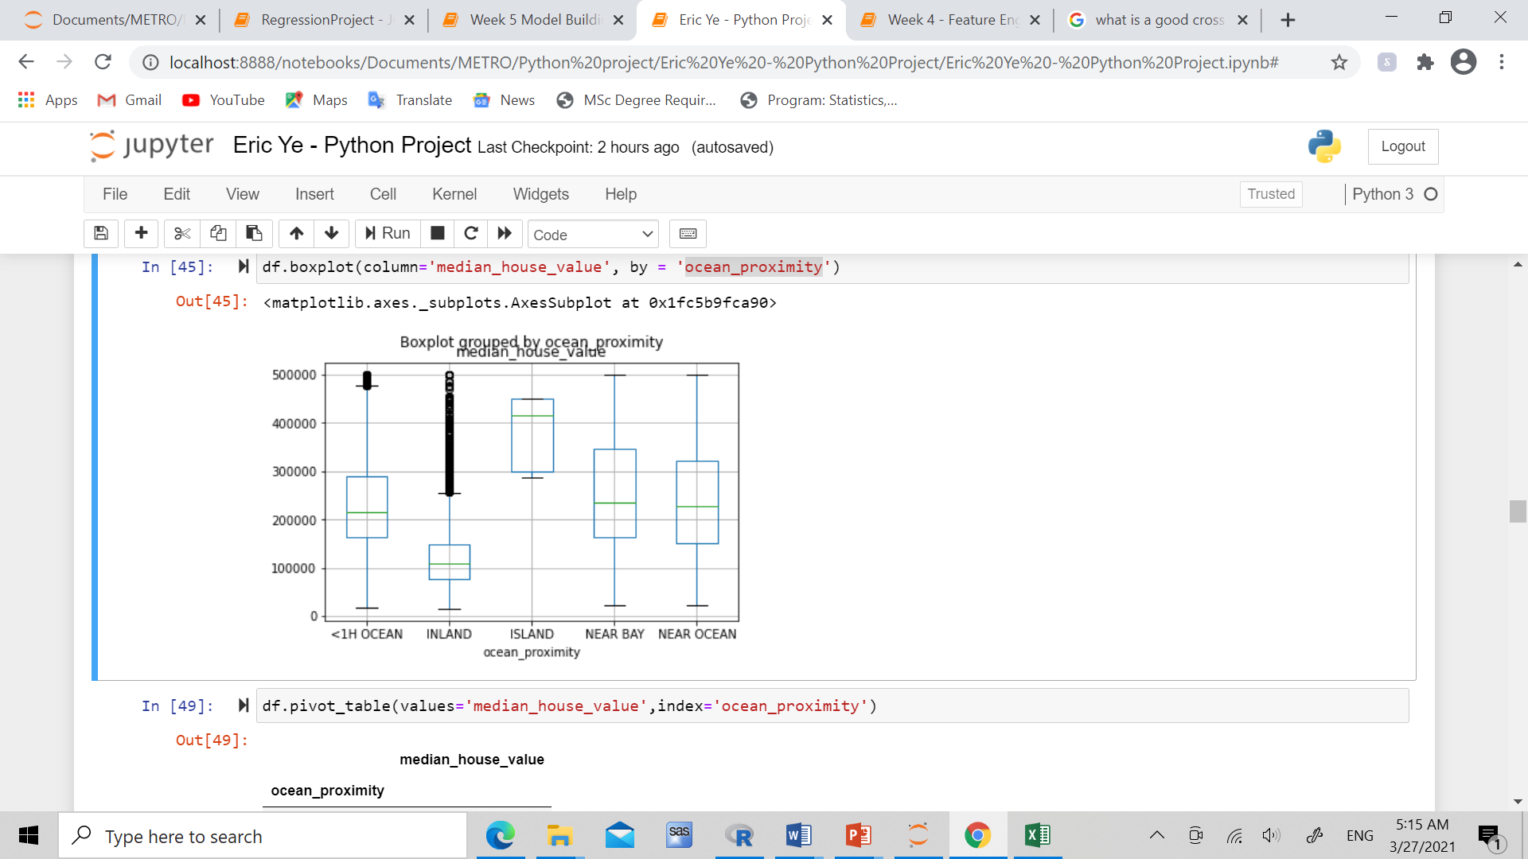
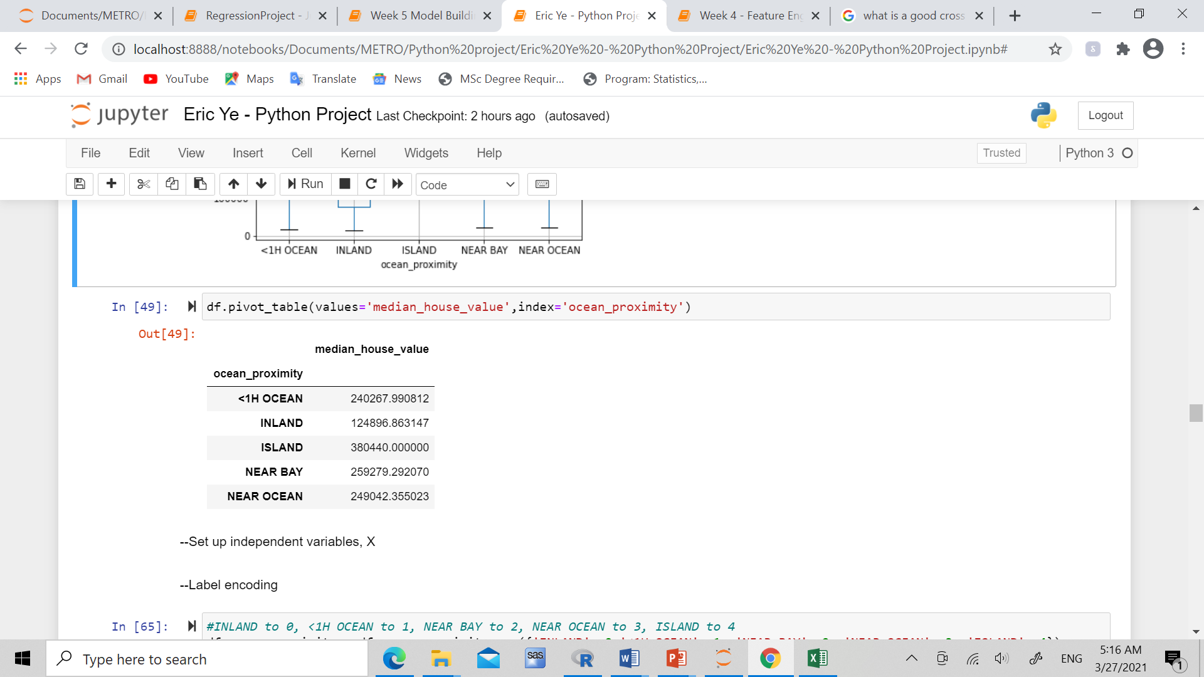
Data Visualization/ Bivariate

Slide 11
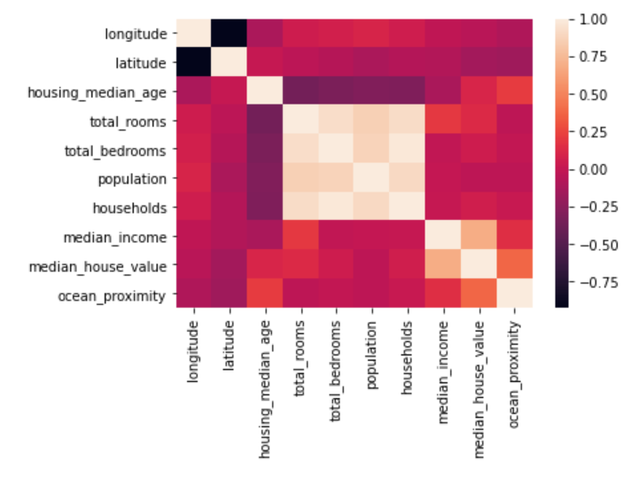
Collinearity of independent variables

Slide 12
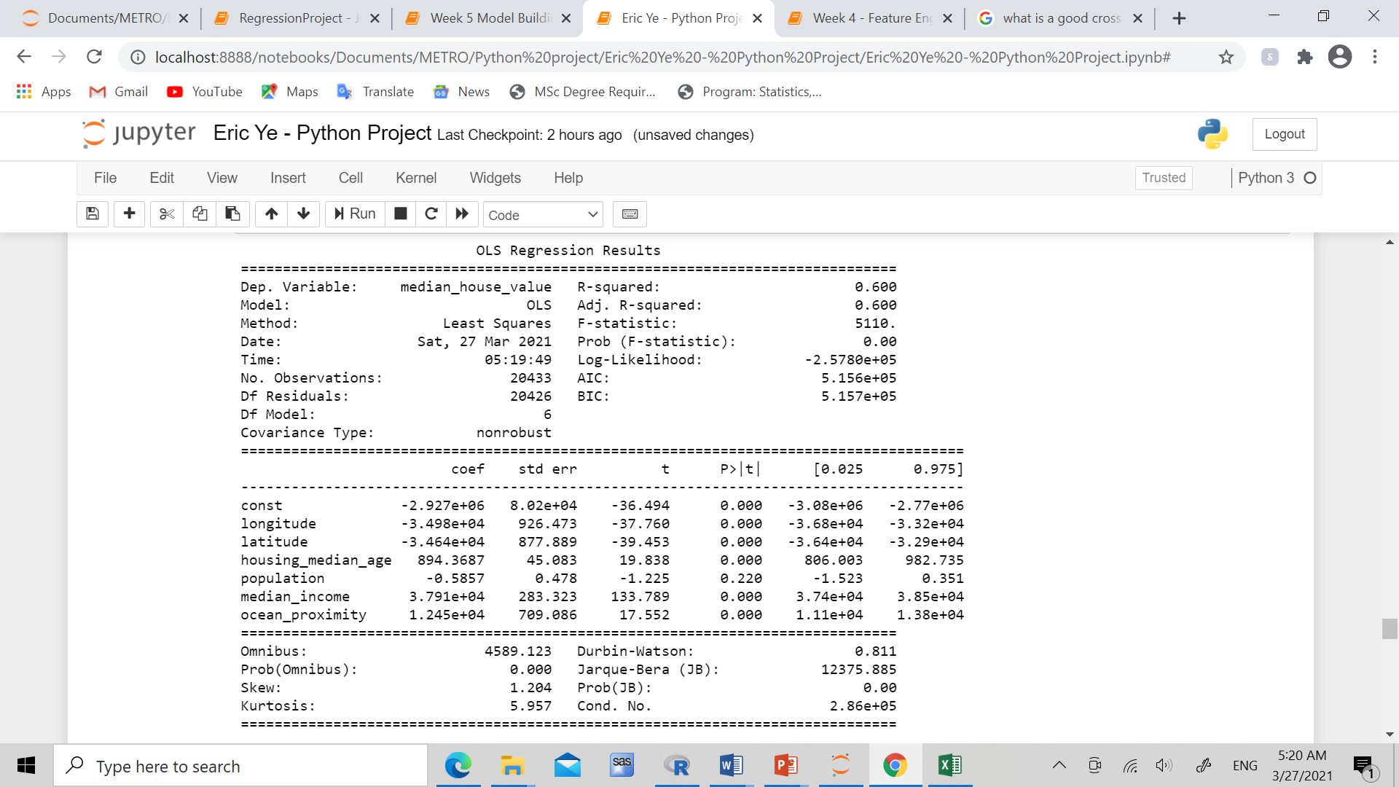
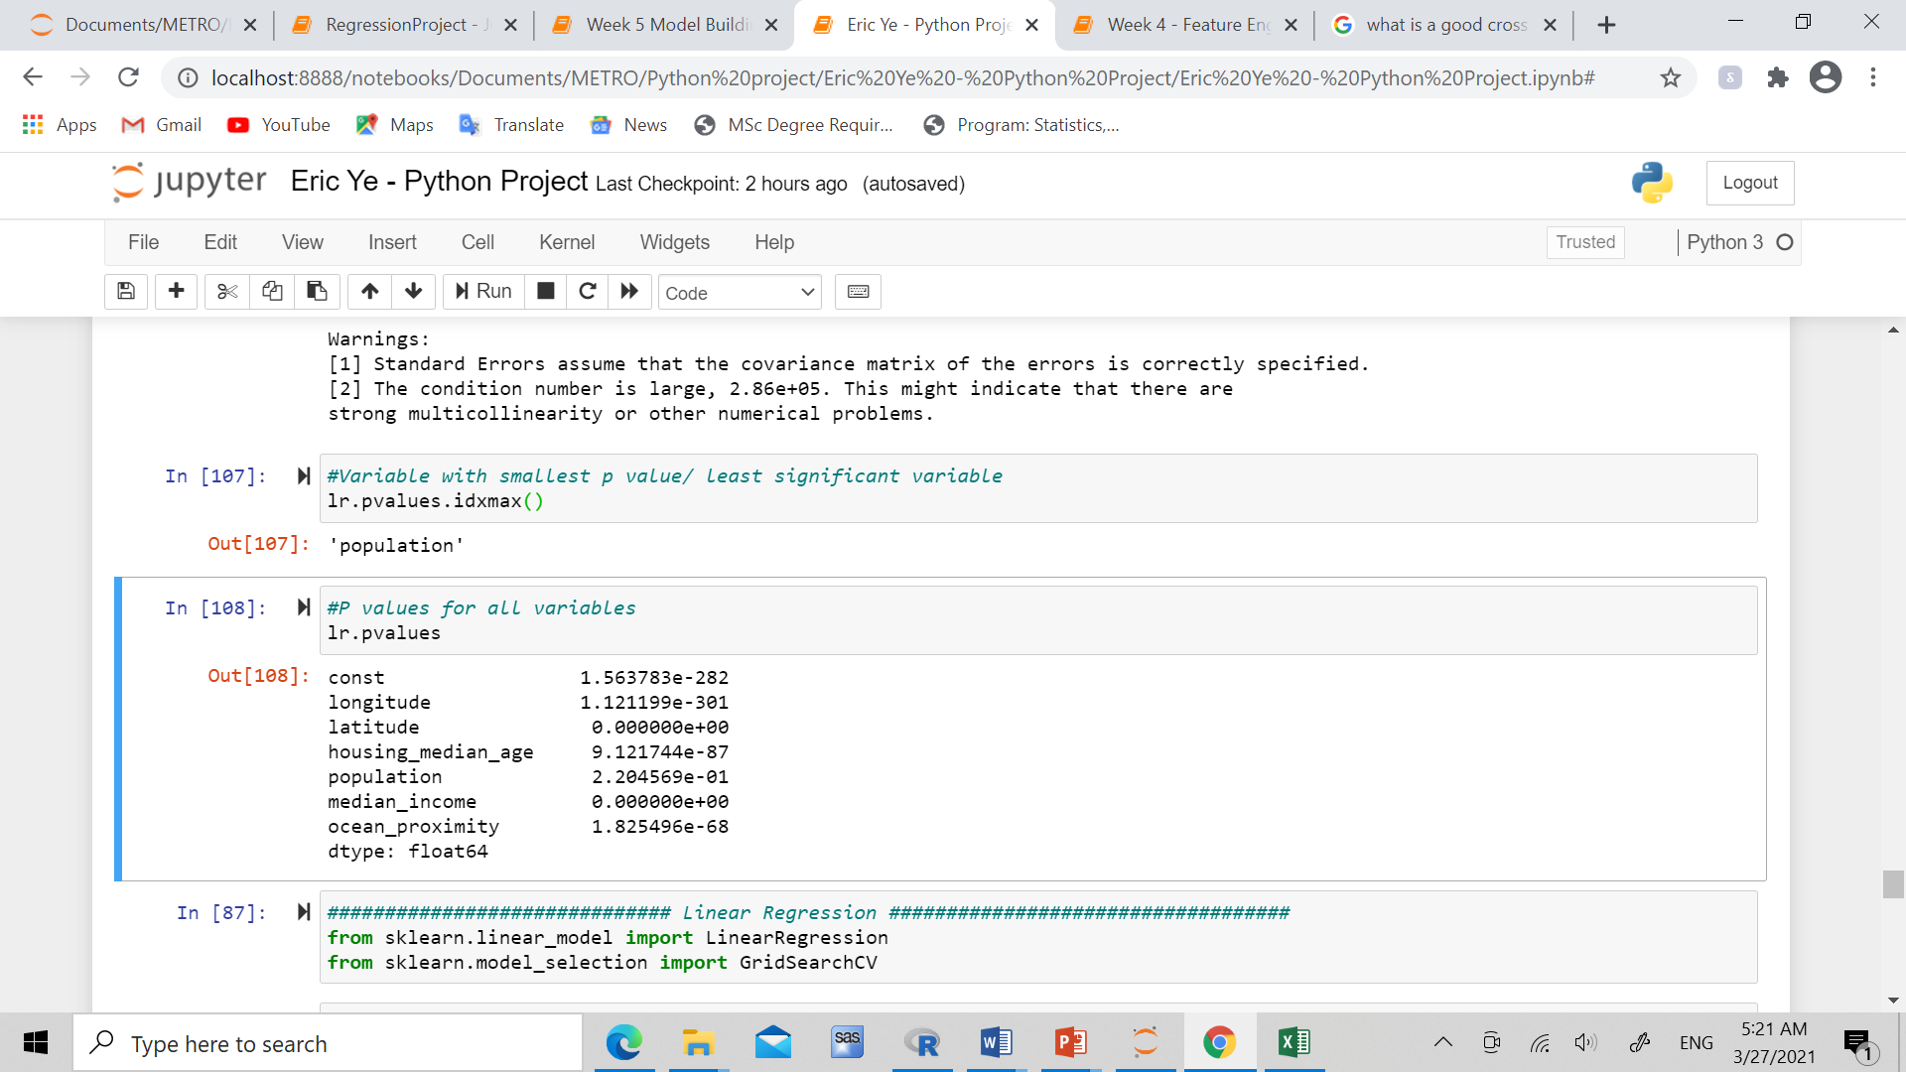
Model Building/ Regression

Slide 13
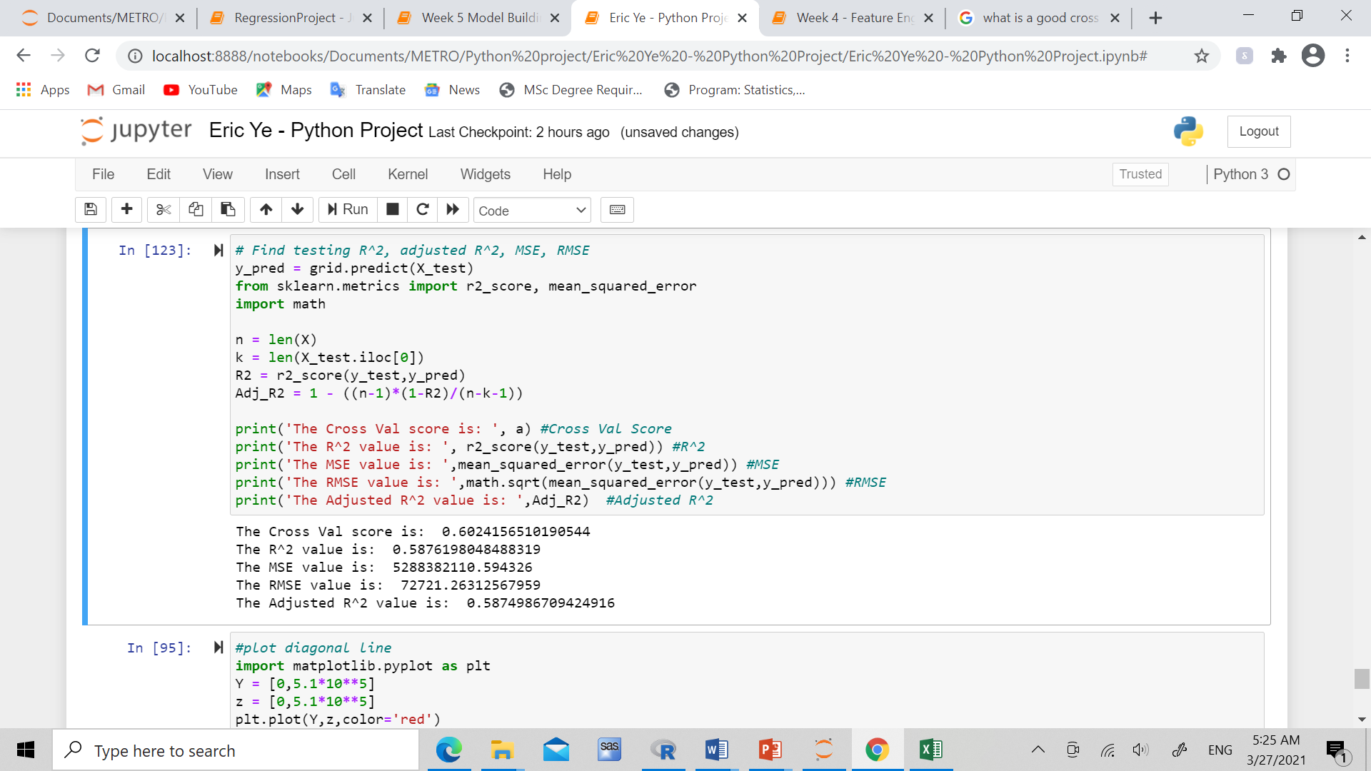
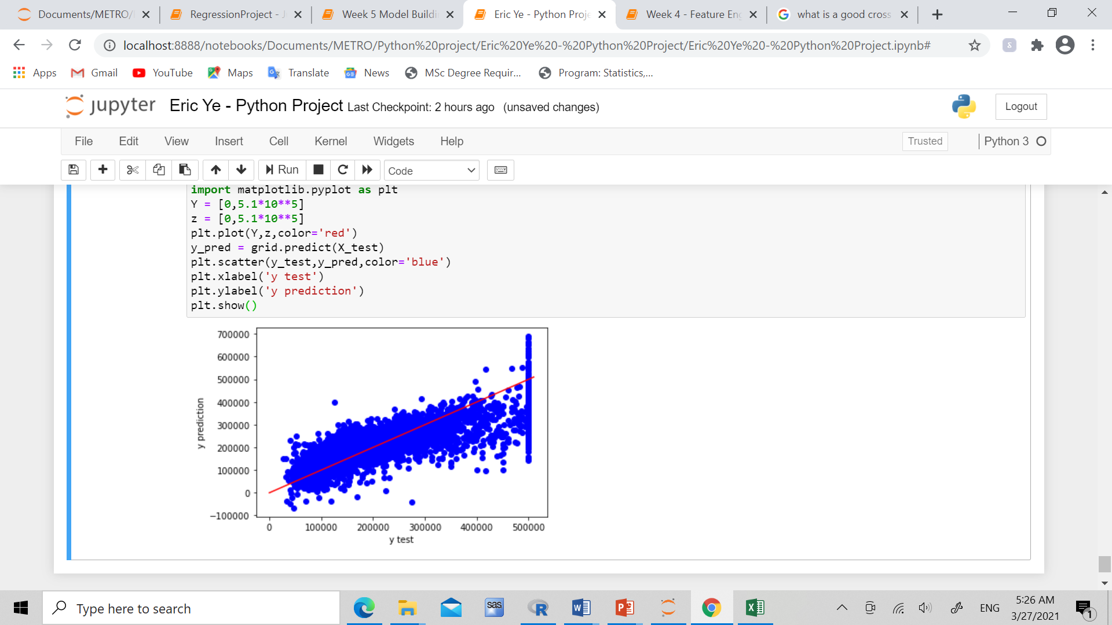

Slide 14
Results/ Findings
Total bedrooms, rooms, population, and number of households in a given block/district is not significant to it’s median house price
There is a very clear correlation between total bedrooms, rooms, population, and number of households in a block
Longitude, latitude, house age, income, and proximity to the ocean are all significant factors when looking at the price of a house in California
Location (longitude/latitude), and income play the biggest factors when considering the price of the house, followed by age of the house, and lastly the distance to ocean(although still significant)

Slide 15
Recommendation/ Suggestion
Real estate company should take into account, different areas and locations which could be targeted for a selected group of customers with specific incomes
Make sure audiences are targeted, for example take customers income into consideration (if possible) when suggesting housing based on location, house age, and proximity to ocean
Newer houses will tend to go for a higher selling price (Newer is better in these cases)
Houses in the islands will sell for much higher prices, houses near the bay, ocean, and within 1 hour of the ocean sell for a little less usually, and houses inland sell cheaper than the other 2 groups

